Slide 1
Business Economics
BCA III Sem
By – Mr. Amit Aggarwal
1

Slide 2
Unit-3
Macroeconomic concerns
Inflation
Unemployment
Trade cycles
Circular flow up to four sector economy
Fiscal policy
Monetary policy
National Income
Measuring National Income and output
Exercise on national Income

Slide 3
Inflation
Inflation is when the prices of goods and services increase.
There are four main types of inflation, categorized by their speed. They are
Creeping
Walking
Galloping
Hyperinflation.

Slide 4
Creeping Inflation
Creeping or mild inflation is when prices rise 3% a year or less. According to the Federal Reserve, when prices increase 2% or less, it benefits economic growth. This kind of mild inflation makes consumers expect that prices will keep going up.

Slide 5
Walking Inflation
This strong, or destructive, inflation is between 3-10% a year. It is harmful to the economy because it heats-up economic growth too fast. People start to buy more than they need to avoid tomorrow's much higher prices. This increased buying drives demand even further so that suppliers can't keep up

Slide 6
Galloping Inflation
When inflation rises to 10% or more, it wreaks absolute havoc on the economy. Money loses value so fast that business and employee income can't keep up with costs and prices. Foreign investors avoid the country, depriving it of needed capital. The economy becomes unstable, and government leaders lose credibility. Galloping inflation must be prevented at all costs.

Slide 7
Hyperinflation
Hyperinflation is when prices skyrocket more than 50% a month. It is very rare. In fact, most examples of hyperinflation occur when governments print money to pay for wars.

Slide 8
Causes of Inflation:
Inflation is mainly caused by excess demand/
        or
Decline in aggregate supply or output.
Former leads to a rightward shift of the aggregate demand curve while the latter causes aggregate supply

Slide 9
(i) Demand-Pull Inflation Theory
According to classical economists inflation is caused by an increase in money supply which leads to a rightward shift in negative sloping aggregate demand curve. Given a situation of full employment, classi­cists maintained that a change in money supply brings about an equi proportionate change in price level.

Slide 10
Cost-Push Inflation Theory
In addition to aggregate demand, aggregate supply also generates inflationary process. As inflation is caused by a leftward shift of the aggregate supply, we call it CPI. CPI is usu­ally associated with non-monetary factors. CPI arises due to the increase in cost of produc­tion. Cost of production may rise due to a rise in cost of raw materials or increase in wages.

Slide 11
Unemployment
Definition: Unemployment – situation when people who are willing, able and available for work are unable to find work.
Unemployment rate formula:
(Number of unemployed people / Labour force) * 100%

Slide 12
Difficulties in measuring unemployment:
Hidden unemployment (working people who are excluded from the measure of unemployment because of the definition of unemployment)
Underemployment (people want full-time jobs, yet are only able to get part-time jobs)
Regional, gender, age and ethnic disparities are not taken into account as it is an average

Slide 13
Consequences of unemployment:
Loss of GDP
Loss of government revenue (tax)
Cost to the government in the form of unemployment benefits
Greater disparities in income distribution
Various social problems (growing unemployment-related crime rates; higher stress levels; homelessness)

Slide 14
Types of unemployment:
Frictional – people are switching jobs
Structural – people are out of job because their skills are no longer required (e.g. technology improved and machinery replaced humans or consumer preferences changed and a service/good is no longer produced)
Seasonal – people are out of job because their workplace only operates seasonally (e.g. skiing resorts)

Slide 15
Cyclical (also known as Demand Deficient) – because of weak demand for various goods and services, firms decrease their output and fire workers
(Real-wage unemployment)

Slide 16
Circular Flow of Income and Expenditure-Four Sector Economy
The circular flow model in four sector economy provides a realistic picture of the circular flow in an economy

Slide 17
Four sector model studies the circular flow in an open economy which comprises of
Household Sector
Business Sector
Government Sector
Foreign Sector

Slide 18
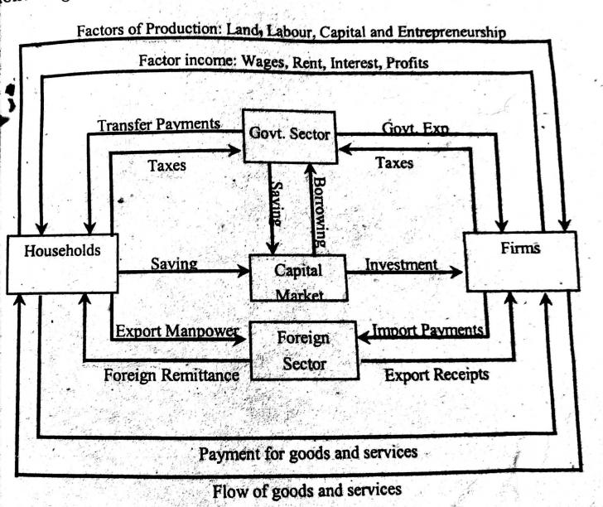

Slide 19
Household Sector
Receipts
The household sector receives factor income in the form of rent, wages, interest, and profit from the business sector. It also receives transfer payments from the government sector.
Payments
The income of the household sector flows into the business sector, government sector and capital markets in the form of consumption expenditure, taxes and savings respectively.

Slide 20
Business Sector
Receipts
The principle receipts of the business sector constitute of income from the sale of goods and services, income from exports, subsidies from government sector, and borrowings from the capital market.
Payments
Factor payments, import payments, and savings constitute the principle payments from business sector to the household sector, government sector, foreign sector and the capital market.

Slide 21
Government Sector
Receipts
The major source of income for the government sector include the taxes paid by household and business sector. Besides this, it also receives interests and dividends for the investments made.
Payments
The government sectors make payments to different sectors in the form of transfer payments, subsidies, grants, etc. It pays to the business sector in return for the goods purchased, makes transfer payments like pension funds, scholarships, etc. to the household sector.

Slide 22
Foreign Sector
Receipts
The foreign sector receives income from the business sector in return for the goods and services imported by the latter.
Payments
Foreign sectors need to make payment to the business sector from where imports have been made.
If exports exceed imports, the economy has surplus balance of payment. In case exports exceed imports, the economy faces a deficit balance of payment.

Slide 23
Definition Of 'Business Cycle'
The fluctuations in economic activity that an economy experiences over a period of time. A business cycle is basically defined in terms of periods of expansion or recession

Slide 24
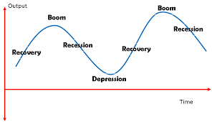

Slide 25
Government in the Macro Economy
Monetary policy
Fiscal policy

Slide 26
Monetary policy
Definition: Monetary policy is how central banks manage liquidity to create economic growth. Liquidity is how much there is in the money supply. That includes credit, cash, checks and money market mutual funds. The most important of these is credit. It includes loans, bonds and mortgages

Slide 27
Objectives of Monetary Policy
The primary objective of central banks is to 1)MANAGE INFLATION
2) REDUCE UNEMPLOYMENT

Slide 28
How monetary policy works
The Central Bank may have an inflation target of 2%. If they feel inflation is going to go above the inflation target, due to economic growth being too quick, then they will increase interest rates.
Higher interest rates increase borrowing costs and reduce consumer spending and investment, leading to lower aggregate demand and lower inflation.
If the economy went into recession, the Central Bank would cut interest rates.

Slide 29
Fiscal Policy
Definition: Fiscal policy is the government spending and taxation that influences the economy. Elected officials should coordinate with monetary policy to create healthy economic growth. They usually don't. Why? Fiscal policy reflects the priorities of individual lawmakers. They focus on the needs of their constituencies

Slide 30

Tools of Fiscal Policy

Slide 31
Definitions of National Income

Slide 32
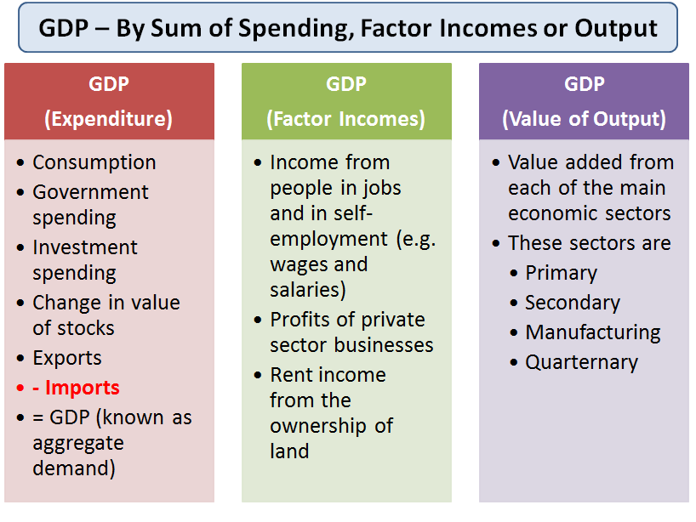

Slide 33
The Expenditure Method - Aggregate Demand (AD)
The full equation for GDP using this approach is
GDP = C + I + G + (X-M) where
C: Household spending on goods and services
I: Capital Investment spending
G: Government spending
X: Exports of Goods and Services
M: Imports of Goods and Services

Slide 34
The Income Method – adding together factor incomes
GDP is the sum of the incomes earned through the production of goods and services. This is:
Income from people in jobs and in self-employment (e.g. wages and salaries)
+
Profits of private sector businesses
+
Rent income from the ownership of land
=
Gross Domestic product (by sum of factor incomes)

Slide 35
Per Capita Gross National Income
How much does each person earn on average? We use per capita measures to give us a guide to this. Income per capita is a way of measuring the standard of living for the inhabitants of a country.
Gross National Income per capita = Gross National Income / Total Population

